Slide 1
SQL -PROJECT
Logistics Optimization for Delivery Routes – Amazon

Slide 2
Task 1-Data Cleaning & Preparation
SUBTASK A
Identify and delete duplicate Order_ID records.
SQL QUERY
Create view new as
(Select Order_ID, Row_Number() Over (Partition BY Order_ID) as rn from orders);
Select * from new;
DELETE FROM ordersWHERE Order_ID IN ( SELECT Order_ID FROM new WHERE rn > 1);

Slide 3
Task 1-Data Cleaning & Preparation
SUBTASK B
Replace null Traffic_Delay_Min with the average delay for that route.
SQL QUERY
Select* from routes;
Select Traffic_Delay_Min from routes where Traffic_Delay_Min IS NULL;
SET @avg_delay := ( SELECT AVG(Traffic_Delay_Min) FROM routes WHERE Traffic_Delay_Min IS NOT NULL);
UPDATE routes
SET Traffic_Delay_Min = @avg_delay WHERE Traffic_Delay_Min IS NULL;

Slide 4
Task 1-Data Cleaning & Preparation
SUBTASK C
Convert all date columns into YYYY-MM-DD format using SQL functions.
SQL QUERY
Update orders
SET Order_Date= date_format(Order_Date, '%Y-%m-%d'), Expected_Delivery_Date = date_format(Expected_Delivery_Date, '%Y-%m-%d'),Actual_Delivery_Date = date_format(Actual_Delivery_Date, '%Y-%m-%d’);
Update shipmenttrackingtable SET Checkpoint_Time= date_format(Checkpoint_Time, '%Y-%m-%d');Select * from orders;

Slide 5
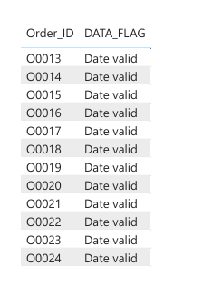
Task 1-Data Cleaning & Preparation
SUBTASK D
Ensure that no Actual_Delivery_Date is before Order_Date (flag such records).
SQL QUERY
ALTER TABLE orders
ADD COLUMN DATA_FLAG varchar(20);
UPDATE ORDERS SET DATA_FLAG=case when Actual_delivery_date > Order_Date then 'Date valid’ else 'Date invalid’ end;

Slide 6
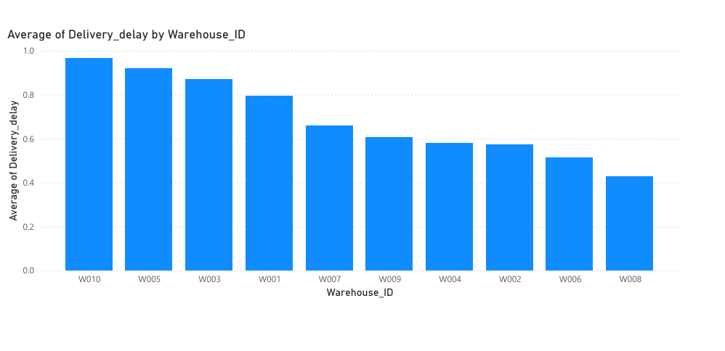
Task 2-Delivery Delay Analysis
SUBTASK A
Calculate delivery delay (in days) for each order
SQL QUERY
ALTER TABLE orders
ADD COLUMN Delivery_delay int;
UPDATE orders
SET Delivery_delay = datediff(Actual_Delivery_Date, Expected_Delivery_Date);
Select* from orders;

Slide 7
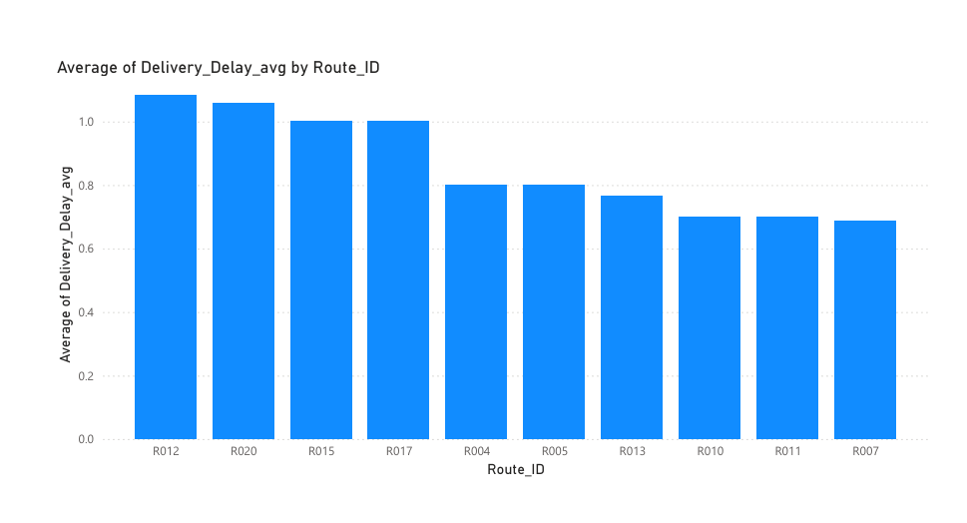
Task 2-Delivery Delay Analysis
SUBTASK B
Find Top 10 delayed routes based on average delay days.
SQL QUERY
Select Route_ID, avg(Delivery_delay) as Delivery_Delay_avg from orders
group by Route_ID
order by Delivery_Delay_avg desc limit 10 ;

Slide 8
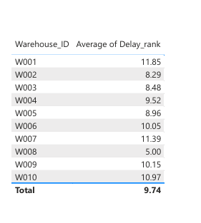
Task 2-Delivery Delay Analysis
SUBTASK C
Use window functions to rank all orders by delay within each warehouse.
SQL QUERY
Select Warehouse_ID, Order_ID, Delivery_delay,
Rank() OVER (partition by Warehouse_ID order by Delivery_delay desc)
as Delay_rank from orders;

Slide 9
Task 3-Route Optimisation Insights
SUBTASK A
For each route, calculate:
Average delivery time (in days).
Average traffic delay.
Distance-to-time efficiency ratio: Distance_KM / Average_Travel_Time_Min.
SQL QUERY
ALTER TABLE routes
ADD COLUMN Distance_to_time_efficiency_ratio float;Update routes
SET Distance_to_time_efficiency_ratio = (Distance_KM)/(Average_Travel_Time_Min);
Create view averages as
SELECT o.Route_ID, ROUND(AVG(o.Delivery_delay), 2) AS Avg_Delivery_Time_Days,
ROUND(AVG(r.Traffic_Delay_Min), 1) AS Avg_Traffic_Delay_Min,
ROUND(AVG(r.Distance_to_time_efficiency_ratio),1) AS AVG_Distance_to_time_efficiency_ratioFROM orders o
JOIN routes r ON o.Route_ID = r.Route_ID
GROUP BY o.Route_ID
ORDER BY Avg_Delivery_Time_Days DESC;Select* from averages;

Slide 10
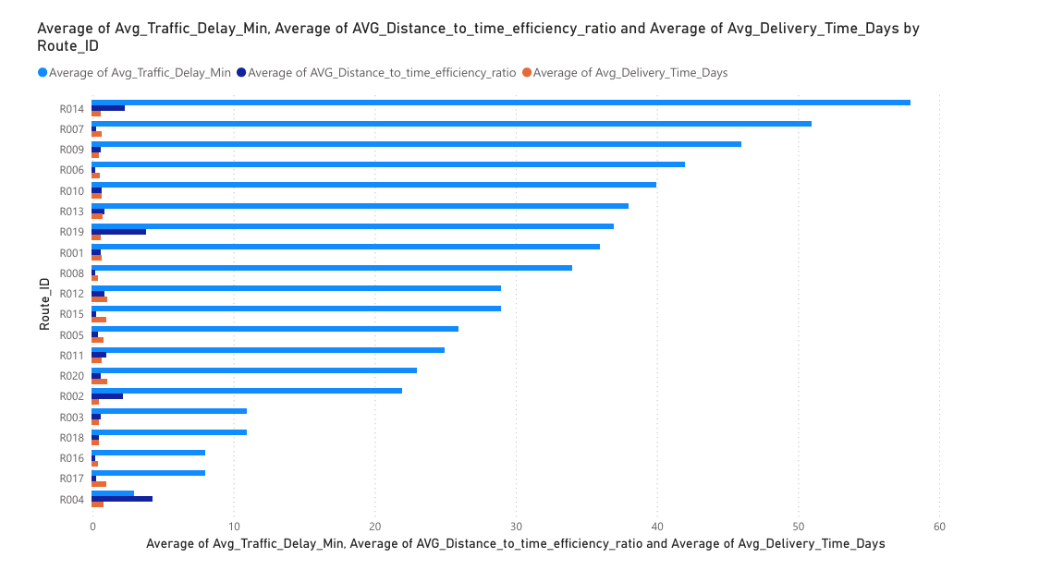

Slide 11
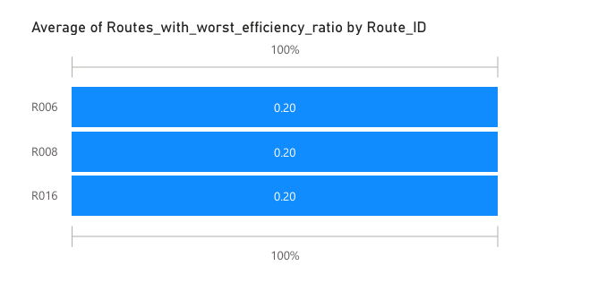
Task 3-Route Optimisation Insights
SUBTASK B
Identify 3 routes with the worst efficiency ratio.
SQL QUERY
Select Route_ID, AVG_Distance_to_time_efficiency_ratio as
Routes_with_worst_efficiency_ratio from averages
order by AVG_Distance_to_time_efficiency_ratio limit 3;

Slide 12
Task 3-Route Optimisation Insights
SUBTASK C
Find routes with >20% delayed shipments.
SQL QUERY
Select Route_ID, count(*) as number_of_shipments,
SUM( CASE WHEN Delay_Reason= 'None' THEN 0 ELSE 1 END) AS Number_of_delays,
ROUND(SUM( CASE WHEN Delay_Reason= 'None' THEN 0 ELSE 1 END)*100/count(*),2) AS Delay_Percentage
from newtable GROUP BY Route_ID HAVING Delay_Percentage> 20;

Slide 13
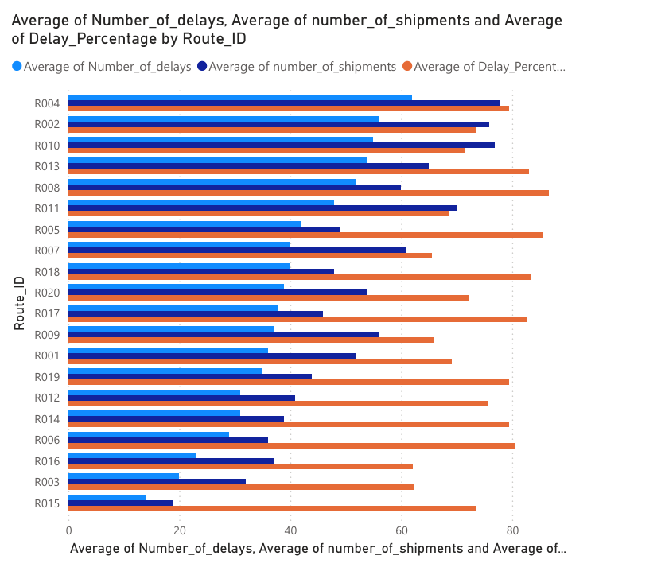

Slide 14
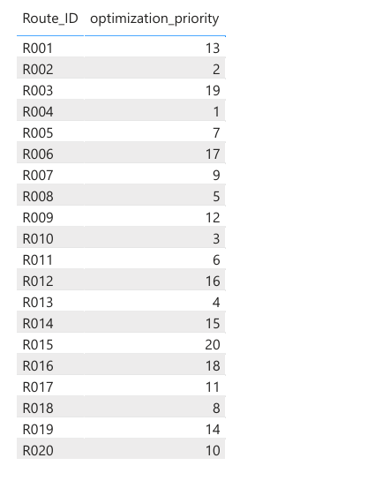
Task 3-Route Optimisation Insights
SUBTASK D
Recommend potential routes for optimization
SQL QUERY
Select Route_ID,number_of_shipments,
Number_of_delays,Delay_Percentage,
dense_rank() OVER (ORDER BY Number_of_delays DESC,
Delay_Percentage DESC) AS optimization_priority from delays;

Slide 15
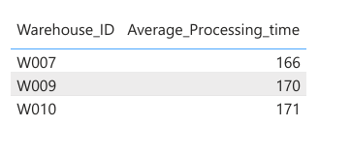
Task 4-Warehouse Performance
SUBTASK A
Find the top 3 warehouses with the highest average processing time.
SQL QUERY
Select w.Warehouse_ID,
ROUND(avg(w.Processing_Time_Min),0) as Average_Processing_time
from orders o JOIN Warehouses w ON o.Warehouse_ID = w.Warehouse_ID
GROUP BY Warehouse_ID ORDER BY Average_Processing_time DESC Limit 3;

Slide 16
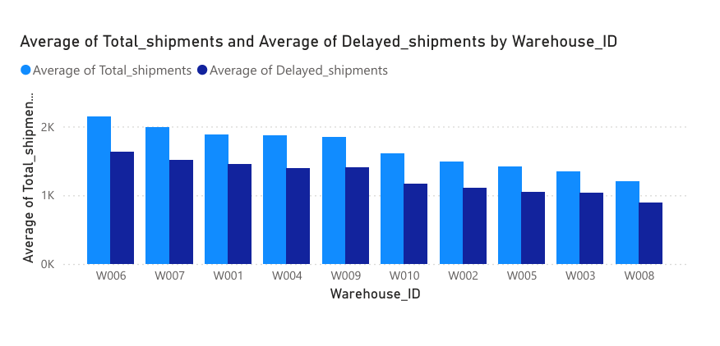
Task 4-Warehouse Performance
SUBTASK B
Calculate total vs. delayed shipments for each warehouse.
SQL QUERY
Select SUM( d.number_of_shipments) as Total_shipments,
SUM(d.Number_of_delayS) as Delayed_shipments,
o.Warehouse_ID from delays d join
orders o
ON d.Route_ID = O.Route_ID group by Warehouse_ID;

Slide 17
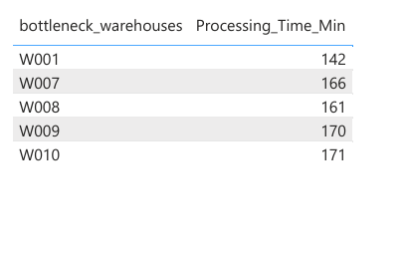
Task 4-Warehouse Performance
SUBTASK C
Use CTEs to find bottleneck warehouses where processing time > global average.
SQL QUERY
SET @avg_processing_time= (Select
avg(Processing_Time_Min) from warehouses);
WITH bottleneck_warehouses AS(Select Warehouse_ID as bottleneck_warehouses,
Processing_Time_Min from warehouses where Processing_Time_Min > @avg_processing_time)
Select* from bottleneck_warehouses;

Slide 18
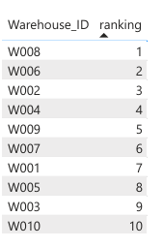
Task 4-Warehouse Performance
SUBTASK D
Rank warehouses based on on-time delivery percentage.
SQL QUERY
Select *,Rank() OVER (ORDER BY
Ontime_delivery_percentage DESC) as ranking
From (SELECT Warehouse_ID, SUM(CASE WHEN
Delivery_Status = 'On Time' THEN 1 ELSE 0 END) AS
Ontime_deliveries, COUNT(*) AS Total_deliveries, ROUND(
SUM(CASE WHEN Delivery_Status = 'On Time' THEN 1 ELSE 0
END) * 100.0 / COUNT(*), 2 ) AS
Ontime_delivery_percentage FROM ordersGROUP BY Warehouse_ID) AS aggregation;

Slide 19
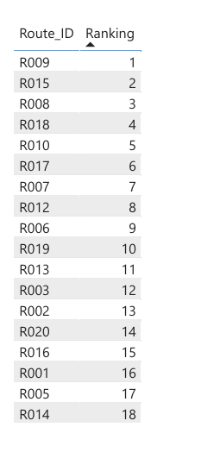
Task 5-DELIVERY AGENT PERFORMANCE
SUBTASK A
Rank agents (per route) by on-time delivery percentage .
SQL QUERY
Select *, Rank() Over( Order by
Average_on_time_delivery_percentage desc) AS Ranking
from ( Select Route_ID , avg(On_Time_Percentage) as Average_on_time_delivery_percentage
from deliveryagents group by Route_ID) AS aggregation;

Slide 20
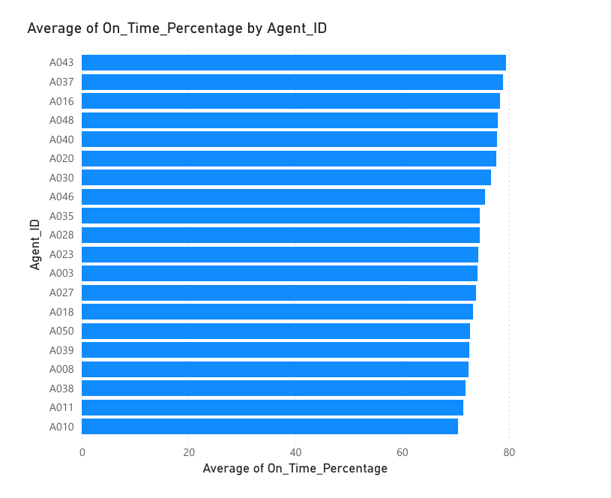
Task 5-DELIVERY AGENT PERFORMANCE
SUBTASK B
Find agents with on-time % < 80%
SQL QUERY
Select *, Rank() Over( Order by
Average_on_time_delivery_percentage desc) AS Ranking
from ( Select Route_ID , avg(On_Time_Percentage) as Average_on_time_delivery_percentage
from deliveryagents group by Route_ID) AS aggregation;

Slide 21
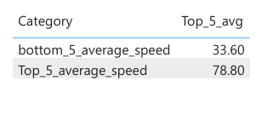
Task 5-DELIVERY AGENT PERFORMANCE
SUBTASK C
Compare average speed of top 5 vs bottom 5 agents using subqueries .
SQL QUERY
Select 'Top_5_average_speed' as Category,
avg (Avg_Speed_KM_HR) as Top_5_avg
from (Select Agent_ID, Avg_Speed_KM_HR from
deliveryagents order by Avg_Speed_KM_HR desc limit 5) AS
Top_5 UNION ALL Select 'bottom_5_average_speed' as Category, avg(Avg_Speed_KM_HR) as Bottom_5
from (Select Agent_ID, Avg_Speed_KM_HR
from deliveryagents order by Avg_Speed_KM_HR asc limit 5) AS Bottom_5;

Slide 22
Task 6-Shipment Tracking Analytics
SUBTASK A
For each order, list the last checkpoint and time.
SQL QUERY
Select Order_ID, max(Checkpoint) as Last_Checkpoint,
max(Checkpoint_Time) as Last_Checkpoint_time from
shipmenttrackingtable group by Order_ID;

Slide 23
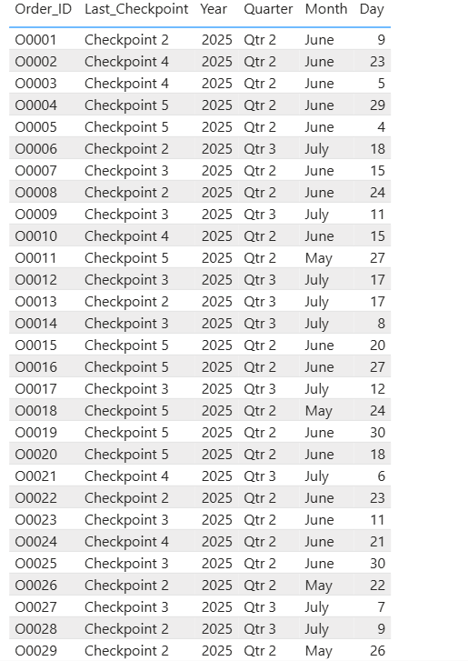
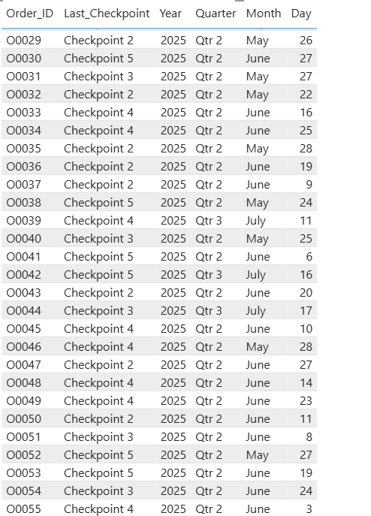
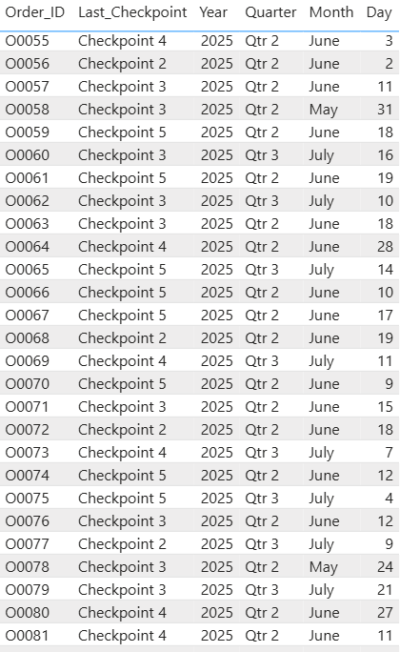

Slide 24
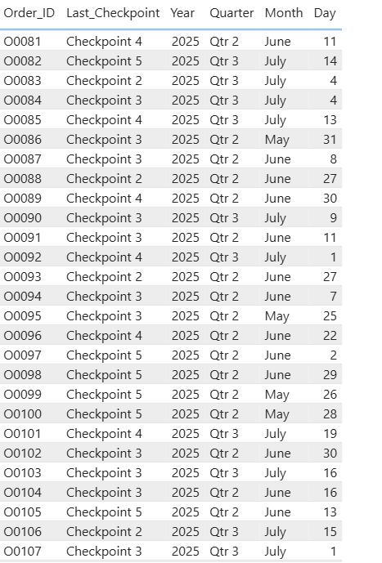
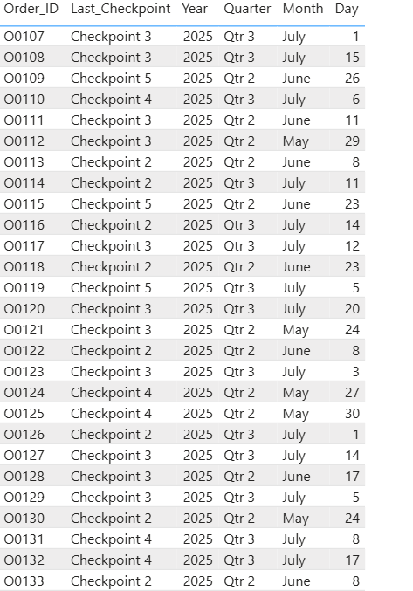
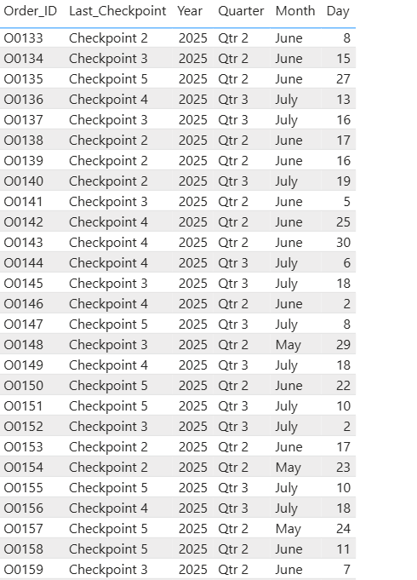

Slide 25
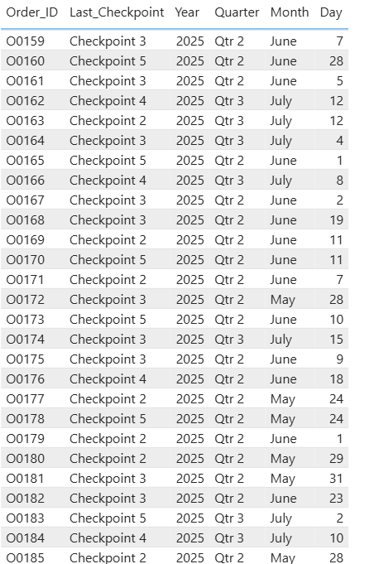
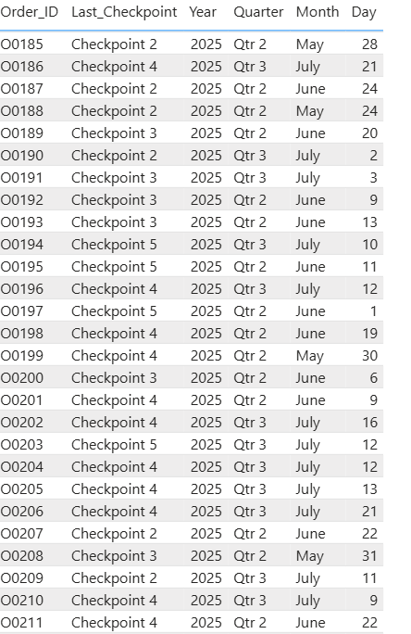
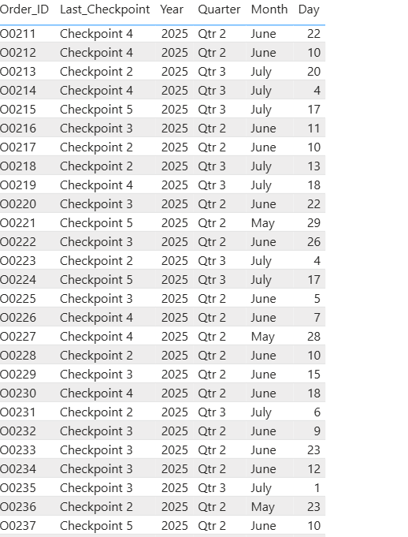

Slide 26
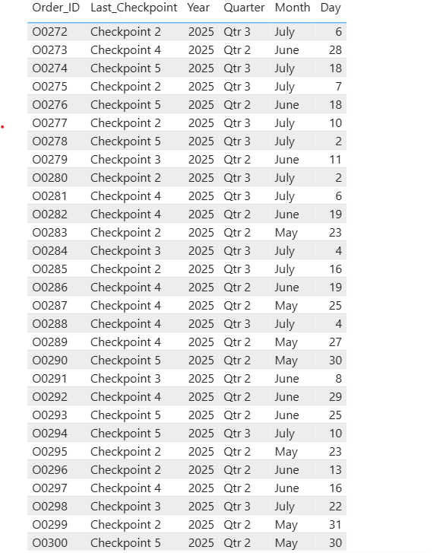

Slide 27

Task 6-Shipment Tracking Analytics
SUBTASK B
Find the most common delay reasons (excluding None).
SQL QUERY
Select max(Delay_Reason) as Most_Common_Delay_reason
from shipmenttrackingtable
where Delay_Reason NOT IN ('None');

Slide 28
Task 6-Shipment Tracking Analytics
SUBTASK C
Identify orders with >2 delayed checkpoints
SQL QUERY
SELECT Order_ID, count(Delay_Reason)
FROM shipmenttrackingtable
WHERE Delay_Reason NOT IN ('None’)
GROUP BY Order_IDHAVING COUNT(Delay_Reason) > 2;

Slide 29
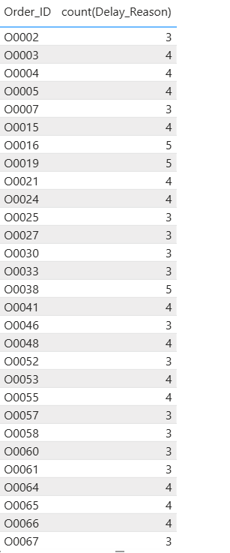
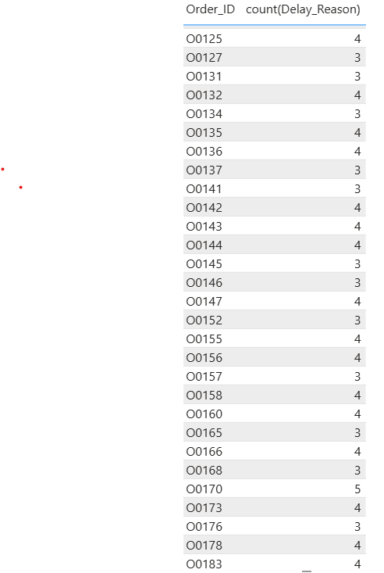
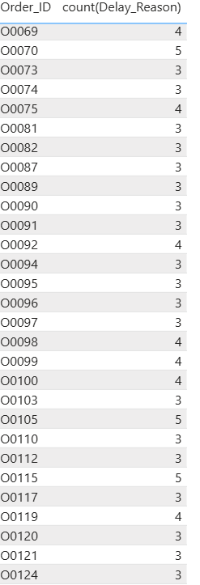

Slide 30
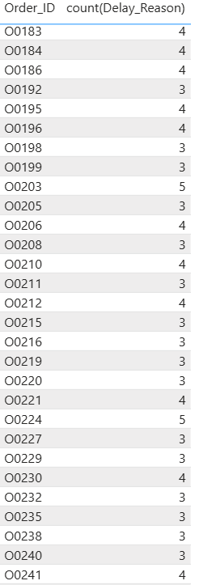
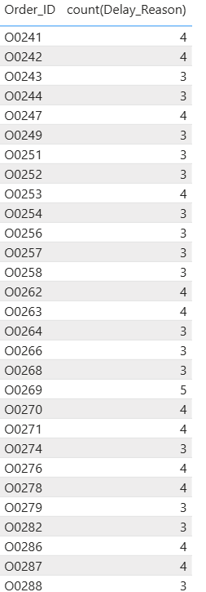
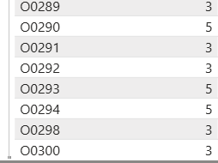

Slide 31
Task 7-Advanced KPI Reporting
Calculate KPIs using SQL queries:
Average Delivery Delay per Region (Start_Location).
On-Time Delivery % = (Total On-Time Deliveries / Total Deliveries) * 100.
Average Traffic Delay per Route.
SQL QUERY
SELECT SUM(CASE WHEN Delivery_Status = 'On Time’
THEN 1 ELSE 0 END) AS Ontime_deliveries, COUNT(*) AS
Total_deliveries, ROUND( SUM(CASE WHEN
Delivery_Status = 'On Time' THEN 1 ELSE 0 END) * 100.0 /
COUNT(*), 2 ) AS Ontime_delivery_percentage FROM orders;
Select Route_ID, Count( Case when Delivery_Status =
‘Delayed' then 1 else 0 end ) as Avg_delay_times from orders
group by Route_ID;

Slide 32
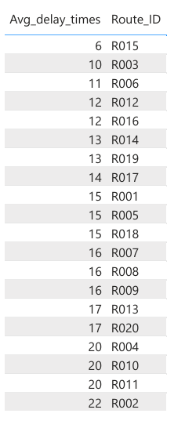

Slide 33
Task 8-PPT Presentation and Video Submission
Link of video
https://www.loom.com/share/665283b7d7d24e068fbc51a895a0f4af

